Slide 1
SEC555
Presentation based on SEC555: SIEM with Tactical Analytics
Sharing Alerts and Threat Intelligence
Justin Henderson (GSE # 108) and John Hubbard
@SecurityMapper @sechubb

Slide 2


About Us
Justin Henderson
SEC555 Author / SEC455 and SEC530 Co-Author
GSE #108 / Cyber Guardian Blue + Red / 60 certs
Owner of H & A Security Solutions
Twitter: @SecurityMapper
John Hubbard
SEC555 / SEC511 Instructor
SEC450 Author / SEC455 Co-author
SOC Lead, GMON | GREM | GPEN
Twitter: @SecHubb

Slide 3
Welcome!
A copy of this talk is available at: https://github.com/HASecuritySolutions/presentations
More free stuff: https://github.com/HASecuritySolutions

Slide 4
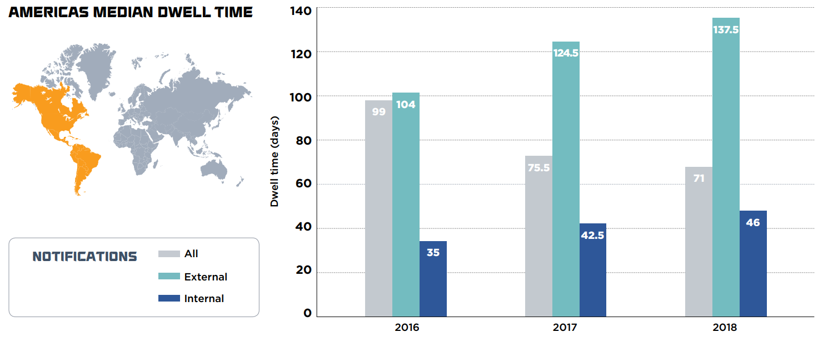
Detection Today
* From Mandiant’s M-Trend 2019 Report

Slide 5
Better Detection
Organizations need better detection and this often is confused with “buy [insert product here]”
Methods to increase detection capabilities
Minimize false positives
Know thyself
Move past only using vendor rules <- webcast focus
Community and private partnerships provide new rules

Slide 6

Sharing is Caring
Is sharing giving away trade secrets? Advising the enemy?
Or does it make things better for you?
Reasons to share:
Altruism – Because it makes you feel good
Self-ism – Because you hope to get more out of it than you give
Both are valid options

Slide 7
How to Share
Multiple methods available for sharing detection capabilities:
GitHub Repositories (public or private)
Docker Images
File Sharing Applications
SSH via the internet (we do not judge - ☺)
Malware Information Sharing Platform (MISP)

Slide 8

GitHub Sharing
PROs
CONs
Version control
Rollback capabilities
Easy sharing
GitHub deploy keys
GitHub enterprise accounts
Free public sharing
Private shares cost (low cost)
Not flexible for dynamic sharing
All or nothing repo access

Slide 9
File Sharing / SSH / Other
PROs
CONs
Been around forever
Easy to script or install app
Files natively on OS
No fancy APIs required
Supports symlinks
Requires SSH keys or 3rd party applications
Requires scripting
Not flexible for dynamic sharing
Requires separate folders
Or fancy scripting

Slide 10
Different Approach
Custom scripts and sharing integrations are awesome
But they also impede progress
Instead of reinventing the wheel organizations need something task built
Such as projects like MISP
Goal is to share between organizations
May not have things like version controlling but it is designed for

Slide 11

MISP
Malware Information Sharing Platform
A free, open-source analyst favorite
Capability of high-volume indicator storage
Great web UI and REST API interface
Classification and sharing functionality
Flexible indicator storage
Easy import/export
Integrates with TheHive for automated storage/analysis

Slide 12


MISP Sharing Illustrated
Org-1 MISP
Org-2 MISP
Events
Events
Shared Events

Slide 13
Problem with Sharing
Proverb: One man’s treasure is another man’s trash
- How do we share without making the problem worse?
Organization 1
True positives only
Low volume
Organization 2
False positives only
High volume
Shared Alert Rule
Shared Alert Rule

Slide 14









Orchestration
Receive Alert Rule
Manually Review / Assess
Convert Alert Rule
Test Alert Rule
result
sigmac
Move into Production

Slide 15
Testing Shared Rules
Building logic for rule testing does not require advanced scripting or deploying a full dev ops team
Did the rule find anything?
Yes – Was it high volume (likely false positive) or low volume (possible true positive)
No - Was the rule computationally expensive (likely poorly written rule) or your organization has never seen the attack
Above is logic for initial implementation
As you mature you can operationalize this further

Slide 16
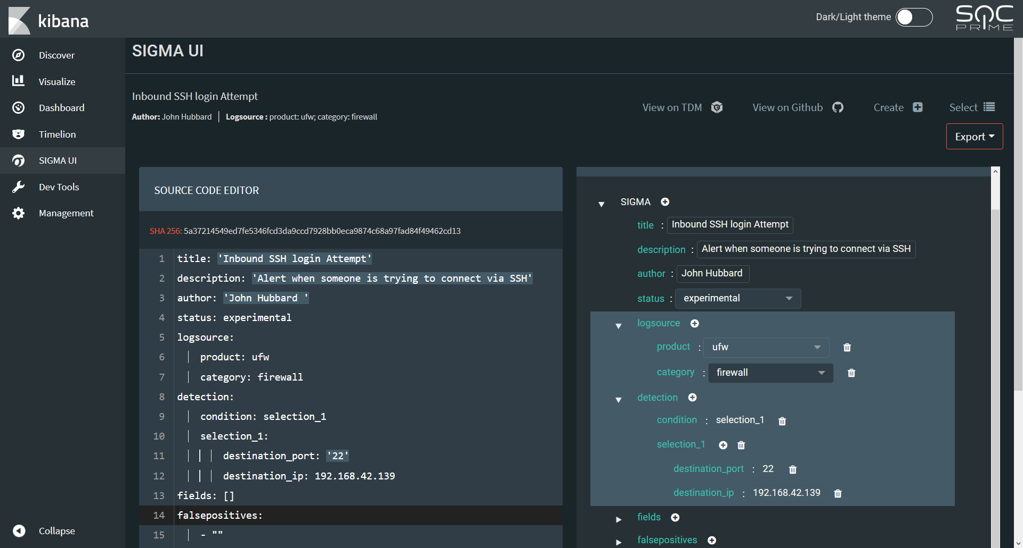
Bonus: SOC Prime SigmaUI!

Slide 17

Rule Organization
Don't know who changed a rule, or why?
Sigma can help with this too!
Most SIEMs don't have alert change tracking
Text based analytics = easy Git version control!

Slide 18
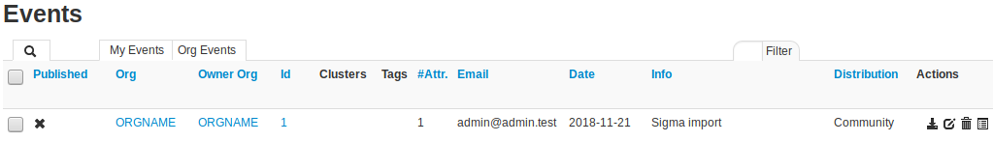
Putting Sigma Rules Into MISP

Slide 19
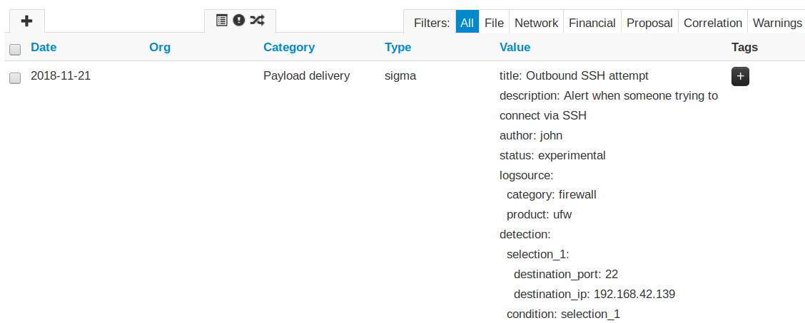
Sigma Attribute Created in MISP

Slide 20
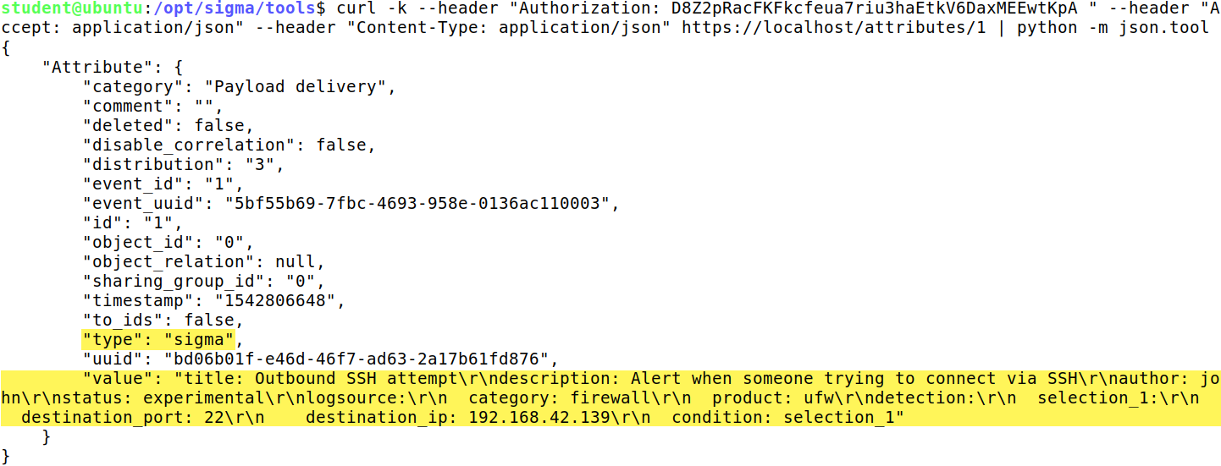
Pulling Rules Out of MISP
Easy to use REST API:

Slide 21




Imagine a world…
Where intelligence reports come with Sigma rules
Don't have to write the analytics
Don't even have to transcribe them
They came to you through MISP!
Analytics automatically appear in Threat Intel Platform
Already associated with threat actors
Supporting IOCs included
Simply convert the rules you want!

Slide 22

Action Steps
Clone the Sigma project from GitHub
Write some analytics to try out
Test against your SIEM
Push rules into MISP (Docker image available)
Start sharing - link MISP to a friend!
Ask friend to share rules with their own MISP
Secretly do not trust friend and implement rule orchestration
Validate, validate, validate!

Slide 23
Projects to Watch
TheHive
Security incident response for the masses!
Plus MISP and Cortex integration
Threat Alert Logic Repository (TALR)
Provides Sigma to STIX to TAXII for sharing
Sigma2MISP
Imports Sigma rules to MISP

Slide 24

SOC Summit

